Slide 1
Model of Service Learning and Recruitment
The Worcester State University and the RFK Children’s Action Corps Fellowship in Social Welfare:
RFK’s Administration Terence Shanley, Sr. VP
RFK’s Lancaster Campus Director David Tivnan
WSU’s Binienda Center for Civic Engagement Mark Wagner, Ph.D.
Urban Studies, Criminal Justice, Psychology, Sociology, Nursing, Communications

Slide 2
Historical Backstory:
What is the history of RFK Children’s Action Corps?
What social services does RFK provide?
How does the WSU – RFK Fellowship forward its mission?

Slide 3
At Risk Youth – RFK’s Lancaster Campus:
Services for more than 50 boys and girls ranging in age from 7 to 18.
Clients referred by the Commonwealth remain in residence anywhere from one month to one year.
Residential care for children with short-term needs, as well as day and after-school programs for off-campus students.

Slide 4
The Fellows Program
Created to attract, develop and retain future leaders
Begins with paid summer training before a student’s senior year
Selects successful students for paid, 6-credit program based on job performance and potential.
Offers full time, benefitted employment on graduation
January – March: Informational Sessions at WSU
March – May: Interviews of Interested students
May: Site Visit to RFK Lancaster Campus
On-Going: Filing for Internships with Department
June – August Summer-long Training
Yearly Cycle

Slide 5
+
for RFK
An educated workforce
Flexibility in filling weekend and evening shifts
A more stable workforce and reduction in turnover
Employees on fast track for promotion
Recent graduates familiar with the system

Slide 6
+
WSU Students
Full time employment throughout the summer
Training:
First Aid/CPR
crisis intervention
suicide prevention
trauma care
human rights
Weekly individual supervision and an assigned mentor
Guaranteed full time employment upon graduation!
Half time employment for 2 semesters / 3 credits per semester

Slide 7
+
for University
Students are introduced to Life Planning Junior Year
Partnership provides resources for paid service learning
Interdisciplinary, experiential learning allows for advancing strategic plan
Model for defining strategic partnerships and studying civic footprints

Slide 8
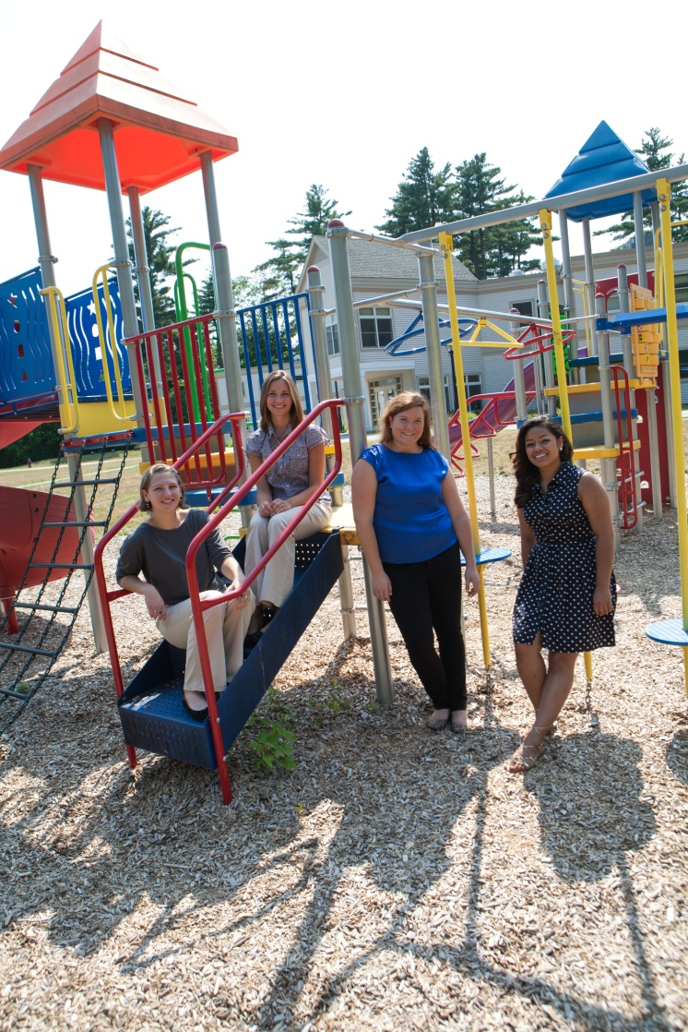
“One of the outcomes that I’ve learned from this job is how to build relationships with clients... The biggest challenge for them is getting the world on their side. They feel like everyone is against them.
You have to learn how to cope with them and connect on their level and they will achieve great things. Being there for them, actually listening to them without being judgmental, is what these kids need.”
- 2013-14 Fellow

Slide 9
“. . .I have learned that the entire process to reach that outcome is a highly individualized process for each child and no two are the same. In most cases, the goal is reunification with their family of origin or placement with a foster family, but some children's plans may include focuses on a particular problematic behavior, issue with school, or legal problem. . . I am often not involved in the planning processes or in setting goals for the children, but rather am tasked with providing a stable and safe environment to assist the children in reaching their goals.” - 2014-15 Fellow

Slide 10
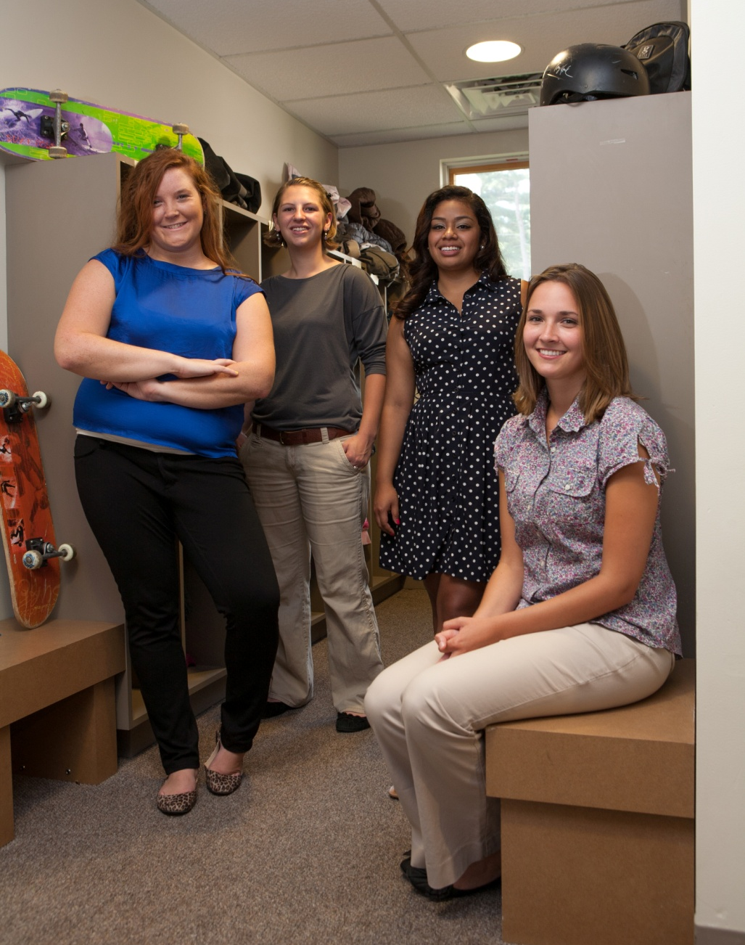
“The hardest part . . . is the realization that I am not a superhero. It is very easy to start . . . with a "savior" mentality and to become discouraged when children make decisions that sabotage their own progress or ruin it all together.”
“At the end of the day, the children are individuals who make their own decisions, I cannot make choices for them, so I have to keep in mind that my role is limited to guiding and role modeling. The children have the greatest responsibility for their own future.”
- 2014-15 Fellows

Slide 11
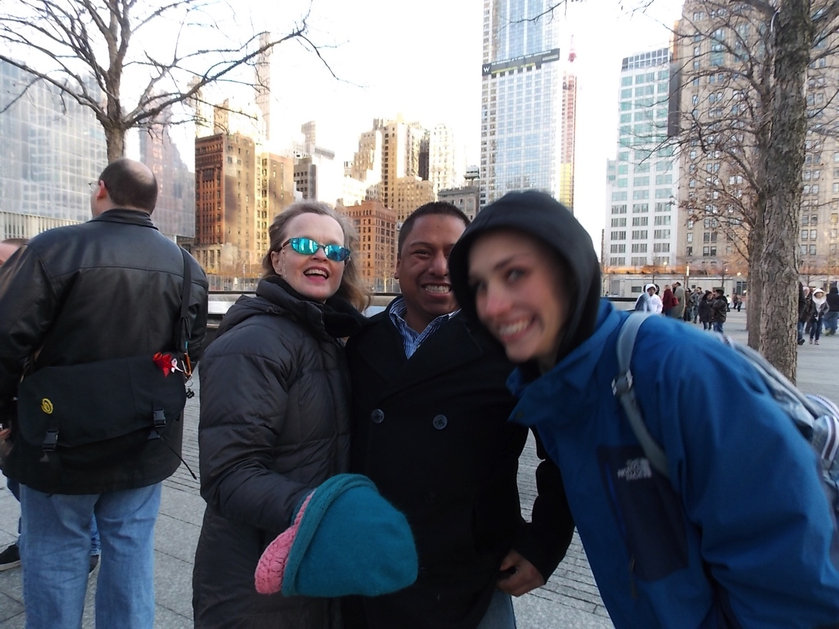
"The hardest thing for me was building the relationships. You can know the ules and ask kids to follow the rules, but until you have formed relationships with the clients they don't always listen. Walking into the program there are 16-18 kids and one of you. You have to learn their names and build relationships immediately, because the sooner you have these relationships in place the sooner you can work with them to improve their lives”.
2013-14 Fellow advanced to
Full-time employee

Slide 12
Q & A
“Justice, dignity, equality – these are words which are often used loosely, with little appreciation of their meaning. I think that their meaning can be distilled into one goal: that every child in this country live as we would want our own children to live.”
Robert F. Kennedy

